Slide 1
CSC1034 – Individual web Reference Guide
By Jack Magee-Tollerton
Student Num: 40482879
Group: 27

Slide 2
My Contributions
Reports:
Report 4 (Average marks with or without assistance)
Report 5 (Find an individual student report)
Report 6 (Find a selected Class-Grade test)
Supporting contributions / functions I made:
getAverageMarksOfAssistanceAndNonAssistance
getStudentsWithAssistance
getStudentsWithoutAssistance
getAllTestResultsForAStudent(Student_ID)
getStudentTestsDataBasedOnAClass(Class_ID)
GetAllStudents
Other contributions:
Search bars for the view and edit forms
The action of removing a test result and adding a test result, and its validations
Validations to do with adding a class or editing a class to a student
Used regex for the phone validations
Also did the ER diagram and the Data dictionary for the database

Slide 3
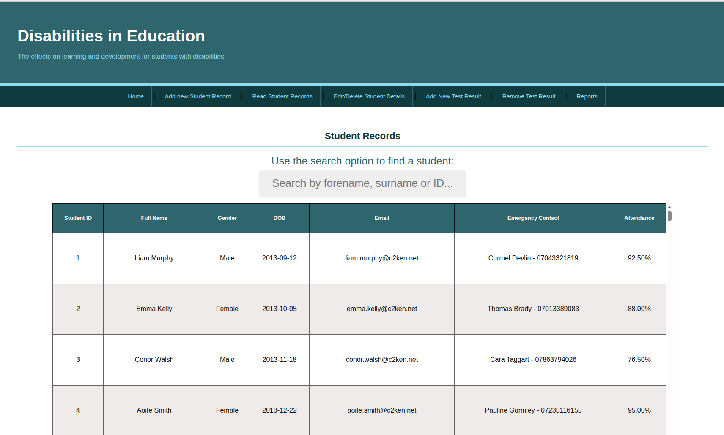
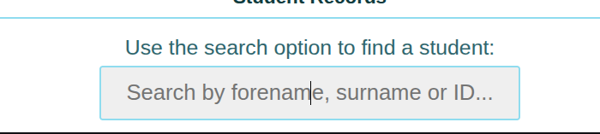
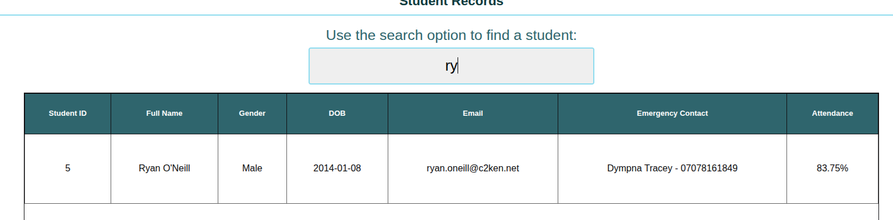
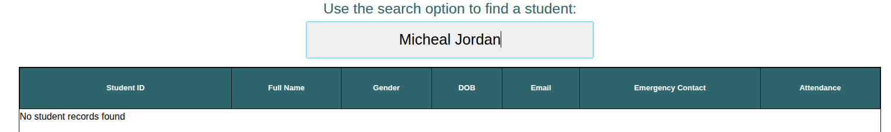
Feature 1: Search options for edit and viewing students
To find a student, go to the search bar, located above the view or edit.
Using the search bar, type in a forename or surname you would like to find:
As you type, the results will vary based on the in-putted text and the results of that text will be displayed
If you search a name of a student who doesn’t exist or hasn’t been added, it will return with “no record found”

Slide 4
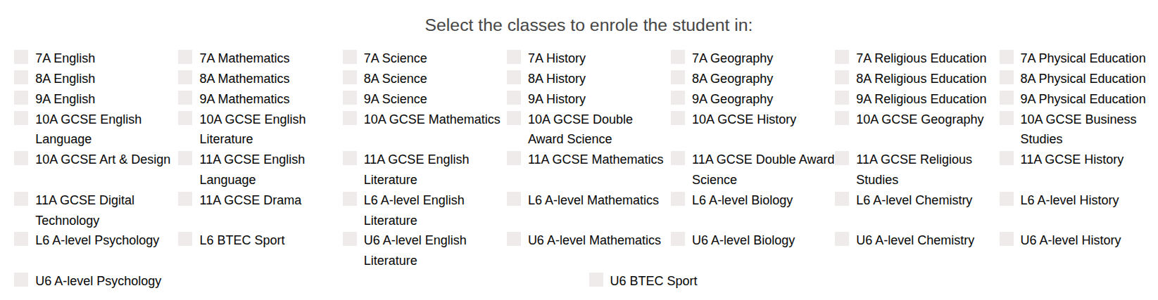
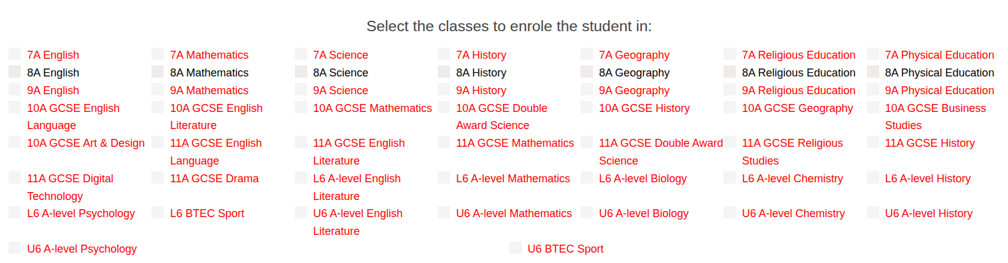
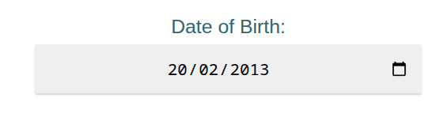
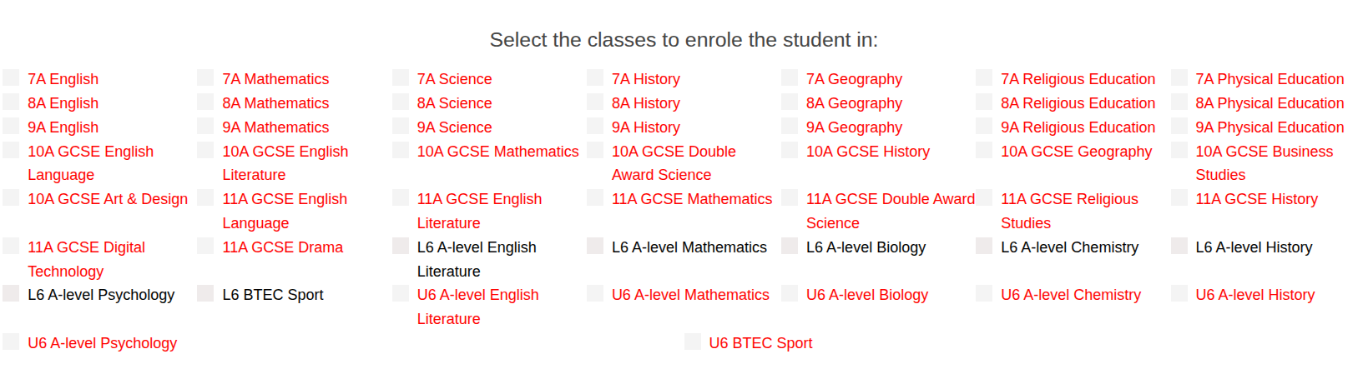
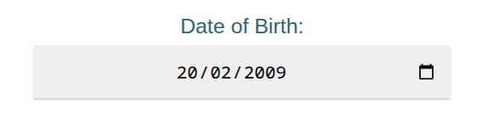
Feature 2: Adding a student to a class
Disclaimer: I did not make the entire “Add student” form, I did some validations such as phone and gender, and “Select the classes to enrol the student in:” part
This is the part of “Adding a new student” that requires the user to add a student to a class.
So when a person is filling out the student details and enters the students date of birth, the choice of classes will filter based on a calculation of which year would that student be in.
For example here, a person born in 2013, can only be enrolled into classes for 1st year (Year 8) whereas the person born in ‘09 would be in lower sixth doing a-levels

Slide 5
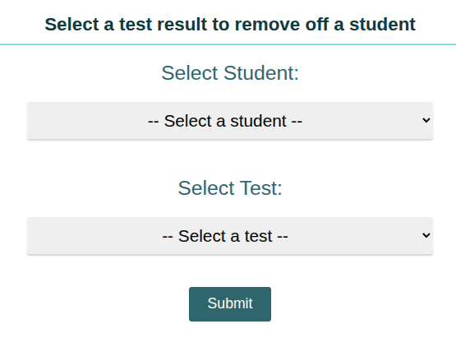
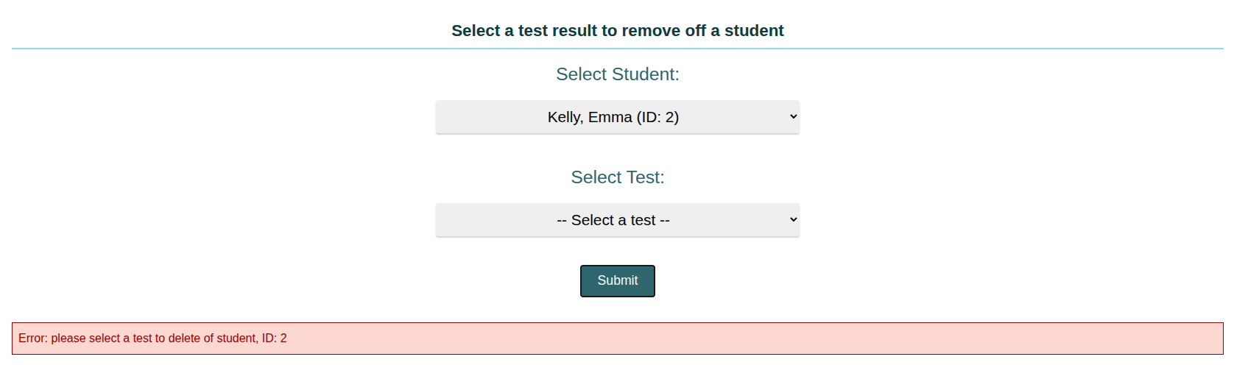
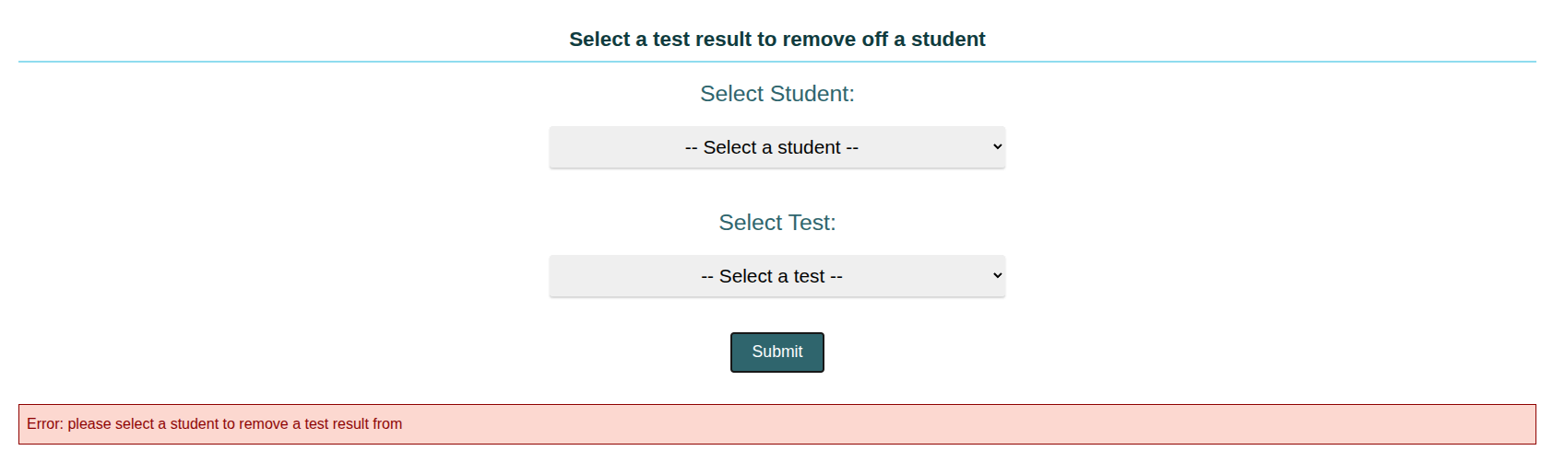
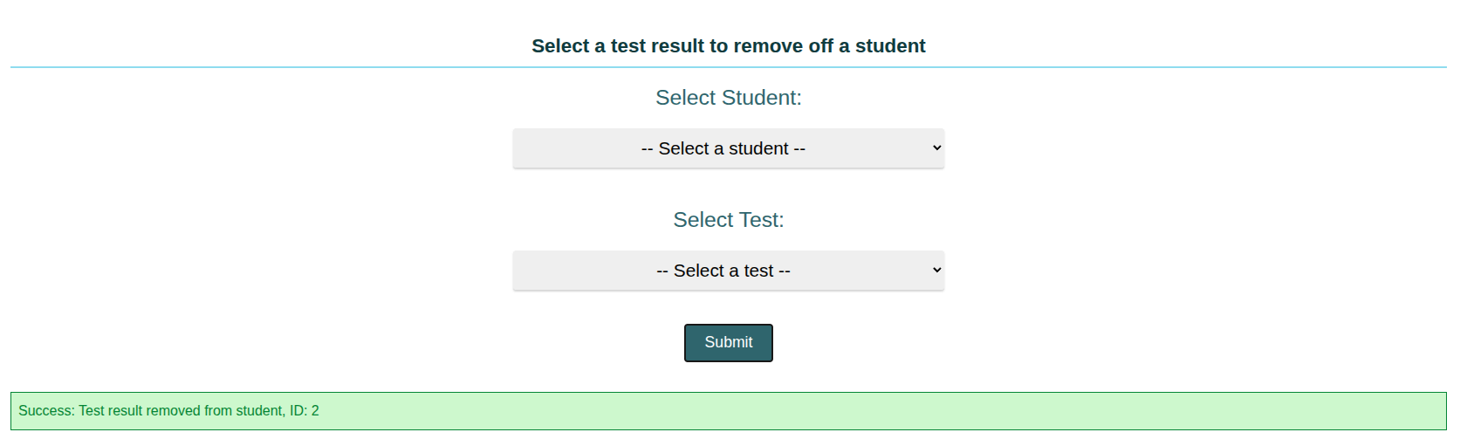
Feature 3: Deleting a test result from a student
This is the main layout for the “delete a test result”
After selecting a student from the list of every student, even trying to submit will cause an error.
Also after selecting a student, any test that a student HAS COMPLETED WILL ONLY APPEAR.
Before even selecting a student, trying a submit, an error comes asking to select a student
After selecting a student and a test, clicking submit will submit and delete that test record from that student, also allowing the same test to be re-added to the student through “add test result” form.

Slide 6
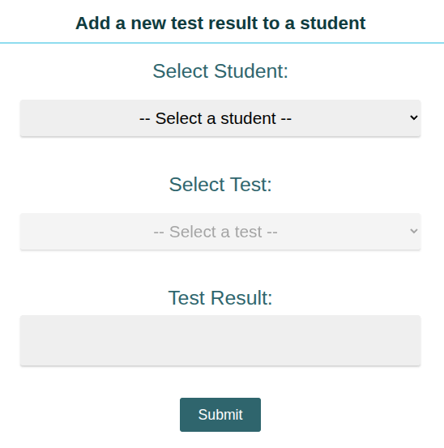
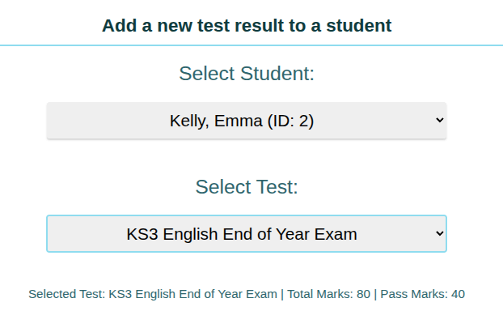
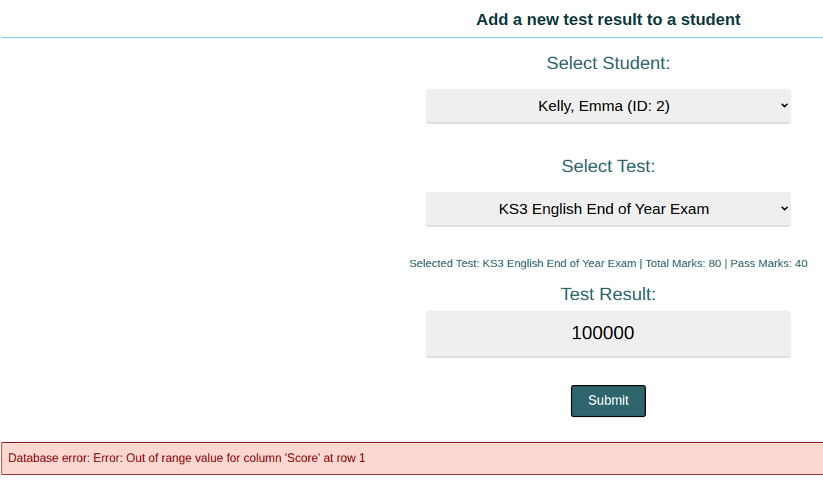
Feature 4: Adding a test result to a student
When a user has selected a test, a total mark and pass mark will appear at the bottom
This is the main page, starting with the select student, then test and enter its result for a valid query
When a user has selected a student, they can only select tests that the user HASN’T DONE but the selected student is enrolled into that class with a “unfinished test”.
If a user tries to enter a number that is above that tests “total marks” value (in the example it is 80), the user will be unable to enter a test result as shown.

Slide 7
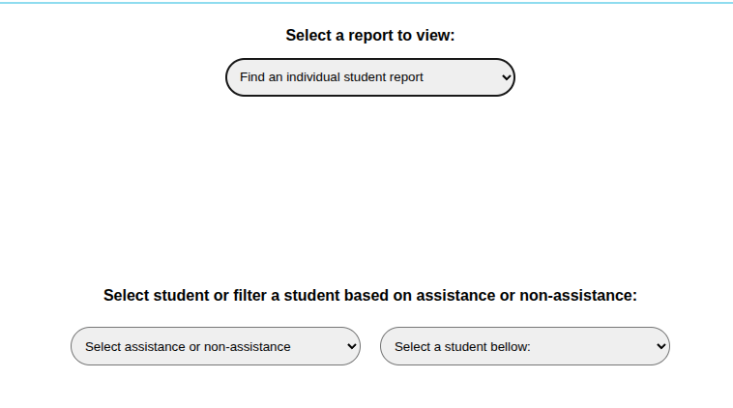
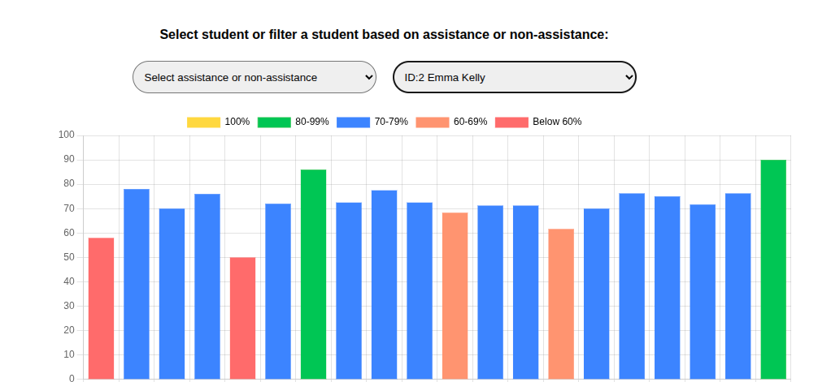
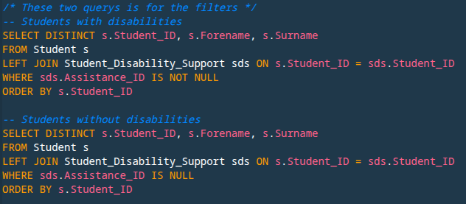
Report: Parametrised Report (Disability filter)
When selecting one of my reports, these input fields appear, this is for filtering students based on if they are disabled or not.
You can filter by “assistance” or “non assistance”, this just filters the “Select student” to only show either students with assistance or without, if you decide not to use the select assistance filter, all students will be in the “Select student” input
After selecting a student, results for that student will appear bellow
These are the two queries that get students based on the filter selected

